Slide 1

Cloud Adoption Framework
Overview
Part 5 – Architect your solutions to optimize your workload

Slide 2
Agenda
Cloud Adoption Framework recap
Evaluating applications against the Well-Architected disciplines.
Cost Management
Resources

Slide 3
Microsoft Cloud Adoption Framework
Business
Platform
Workload
Define strategy
Understand motivations
Business outcomes
Business justification
Prioritize project
Adopt
Ready
Azure readiness guide
First landing zone
Expand the blueprint
Best practice Validation
Migrate
• First workload migration
• Expanded scenarios
• Best practice validation
• Process improvements
Manage
Business commitments
operations baseline • Ops maturity
Innovate
• Innovation guide
• Expanded scenarios
• Best practice validation
• Process improvements
Plan
Digital estate
Initial organization alignment
Skills readiness plan
Cloud adoption plan
Govern
Methodology • Benchmark
initial best practice • Governance maturity
Well-Architected
Operational Excellence | Performance Efficiency | Reliability | Security | Cost Optimization
Notes:
This slide is intended to set the direction for CAF and showing the intersect with Well-Architected.
The next slide is an example of how we talk to Governance..

Slide 4
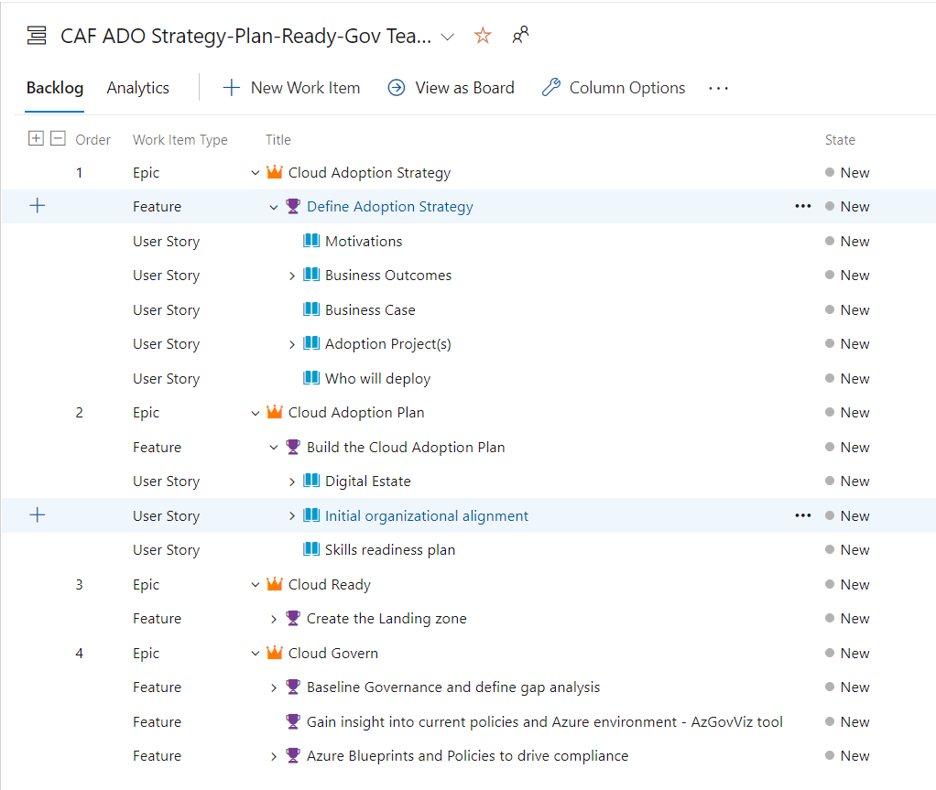


DevOps Recap
Build & Test
Deploy
DevOps is the union of people, process, and products to enable continuous delivery of value to your end users.
Develop
Operate
Continuous Delivery
Plan & Track
Monitor & Learn
Azure DevOps
GitHub

Slide 5

Well-Architected at Microsoft
Partner &
Service Offers
Documentation
Azure Well-Architected Review
Cost Optimization
Security
Operational
Excellence
Reliability
Performance Efficiency
Reference
Architectures
Design Principles
Azure Advisor
Notes:
<Key point>: Well-Architected at Microsoft means achieving your business objectives with an ecosystem of best practices, assessments, and technical guidance that includes….
<Talking Points>
Azure Well-Architected Framework enables you to achieving your business objectives, operationalizing how to design, build, and optimize cloud solutions.
Microsoft Azure Well-Architected Review provides evaluates workloads with gap analysis and identifies areas of where to focus your optimization efforts.
Reference Architectures help you to build and deploy any workload to scale and meet your business needs.
Design principles based on proven practices and design patterns from successful customer and partner deployments.
Microsoft Partner & Service Offers support you—and help you build effective cloud solutions.
<Transition>: Now you have some idea about the foundational ideas of what Microsoft Azure Well-Architected means, let’s dive into the framework itself…

Slide 6
Microsoft Azure Well-Architected Framework
Architecture guidance and best practices, created for architects, developers and solution owners, to improve the quality of their workloads, based on 5 aligned and connected pillars
Cost Optimization | Operational Excellence | Performance Efficiency | Reliability | Security
https://aka.ms/architecture/framework
Notes:
<Key point>: Microsoft Azure Well-Architected Framework enables cloud solution success.
<Talking Points>
Well-architecting
Operationalizes Microsoft Azure Well-Architected Framework’s 5 principles : cost optimization, operational excellence, performance efficiency, and reliability.
Design, build, and optimize cloud solutions, using architectural guidance, assessments, and industry best practices.
Cost-Optimization: Design "pay-as-you-go" cost-effective workloads, aligned with business objectives/ROI, while maintaining a budget.
Operational Excellence: Design reliable, predictable, automated deployments, with monitoring, performance management, and extensive automated and manual testing from an infrastructure and application perspective.
Performance Efficiency: Lower maintenance costs, improve user experience, and increase agility by architecting solutions with scalability baked-in. Move to PaaS by default, to use built-in scaling functionality.
Resiliency: Scale out instead of scaling up with expensive hardware, and build reliability across deployments with resilient, HA applications, and failure mode analysis.
Security: Build with security by design--to provide confidentiality, integrity, and availability assurances against deliberate attacks and abuse of your valuable data and systems.
<Transition>: Now you have some idea about the foundational principles, we will walk through some Best practices to drive workload quality.

Slide 7
Best practices to drive workload quality
Cost Optimization | Operational Excellence | Performance Efficiency | Reliability | Security
Azure Hybrid Benefit Reserve Instances Shutdown Resize Move to PAAS | DevOps Deployment Monitor Processes and cadence | Design for scaling Monitor performance | Define requirements Test with simulations and forced failovers Deploy consistently Monitor health Respond to failure and disaster | Identity and access management Infra protection App security Data encryption and sovereignty Security operations
https://aka.ms/architecture/framework

Slide 8
Show n’ Tell
Well-Architected content
Assessment
Azure Advisor | Cost Management | PowerBI
A practical cost optimization

Slide 9
Links and references
http://aka.ms/adopt
http://aka.ms/adopt/plan/generator
https://docs.microsoft.com/en-us/azure/architecture/framework/
https://channel9.msdn.com/

Slide 10
Thank you !!!

